Slide 1
Floating Point Arithmetic
Jiaming Xu
2023-9-20

Slide 2
<1997 Extended-precision Format
IEEE 754 (1985)
IA32 (1985), x86-64 (1999), Itanium (2001), Motorola 6888x, FPA10 (ARM), x87
80-bit extended-precision format floating point register
1-bit sign, 15-bit exponent, 63-bit fraction
Everything works well?
NO! Something frustrating happened!

Slide 3
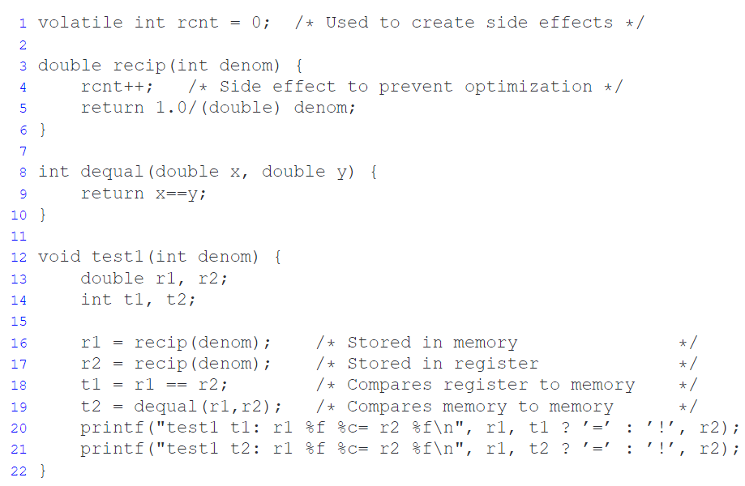

<1997 IEEE 754 Extended-precision Format
Unconsistency between register and memory

Slide 4
≥ 1997 Streaming SIMD Extensions
Pentium MMX (1997) SSE (single-precision FP arithmetic)
Pentium 4 (2001) SSE2 (single/double-precision FP arithmetic)
All processors capable of executing x86-64 code support SSE2 or higher
8x (with IA32) or 16x (with x86-64) XMM registers of 128 bits each

Slide 5
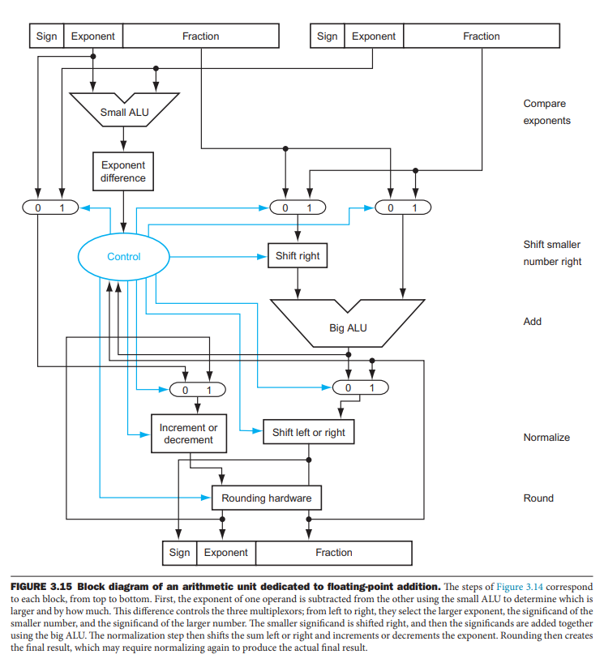
≥ 1997 SSE
Logic circuit diagrams

Slide 6
≥1997 Streaming SIMD Extensions
Integer-like action
Friendly for evaluating expressions containing a mixture of data types
Better performance
move data back and forth between registers and memory less
Probability of parallel operations on packed data
More on Chapter 5

Slide 7
Reference
Extended precision - Wikipedia
CS:APP Web Aside DATA:IA32-FP: Intel IA32 Floating-Point Arithmetic
CS:APP2e Web Aside ASM:SSE: SSE-Based Support for Floating Point
Computer Organization And Design: The Hardware/Software Interface (David a. Patterson, John L. Hennessy) Chapter 3

